Slide 1
Open Science Bootcamp
August 2025

Slide 2
Study Overview
Prospective longitudinal study of child development from pregnancy through first 10 years of life
Focus on trajectories of brain development, physical and mental health
Understanding effect of both adverse and protective environments including socioeconomic, fetal exposures to substances, effects of postnatal experience (e.g., stress), COVID-19/pandemic, nutrition, social stressors on cognitive, behavioral and mental health
Biospecimens captured for substances, genetics/epigenetics, -omics, nutrition, etc.
Target sample size ~7,000 mother child pairs recruited in mid-pregnancy over 3 years

Slide 3

Funded in part by the HEAL Initiative with funding by 10 NIH institutes and centers including NIAAA, NIMH, NICHD, NIEHS, NIMHD, OBSSR; led by NIDA
Funding started 10/1/2021
Pilot phase began late 2022; full implementation started July 2023

Slide 4
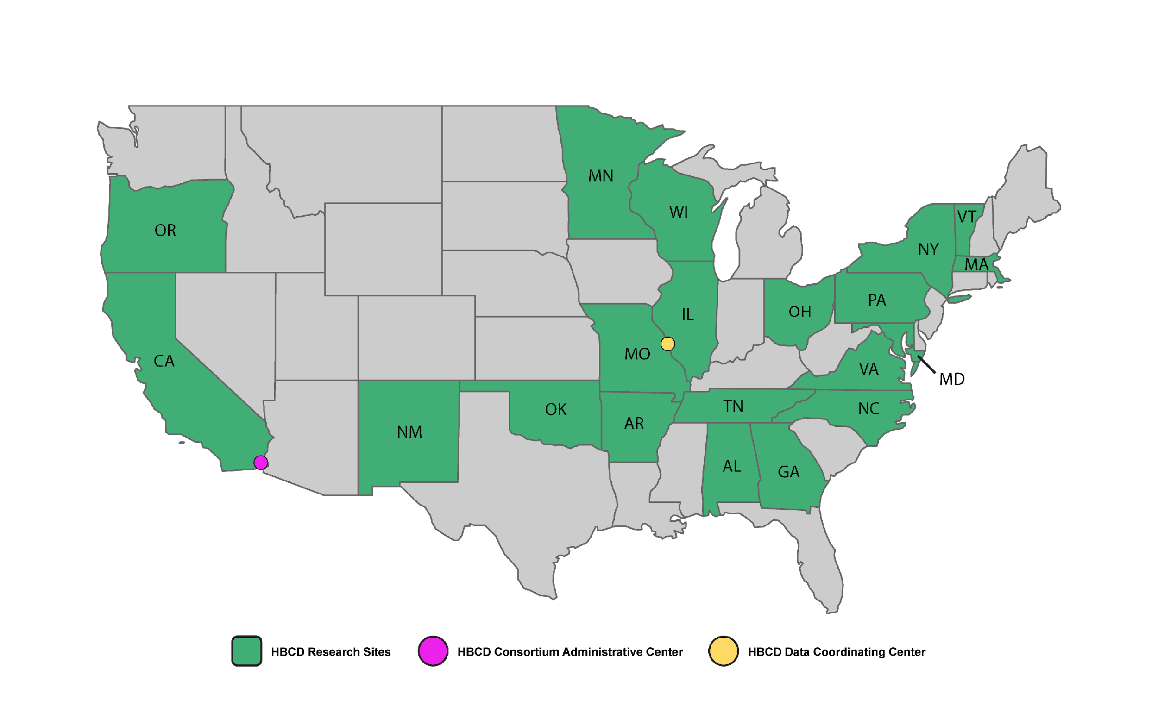
Notes:
Virginia site added.

Slide 5
HBCD ➜ ➜ ➜ ABCD
This is the largest, most representative study of its kind and will provide a rich and detailed look at brain and behavioral development from mid pregnancy until the beginning of adolescence
By ending at the point in development when ABCD begins, we will have a representative sample of more than 20,000 children studied across 2 decades of life

Slide 6
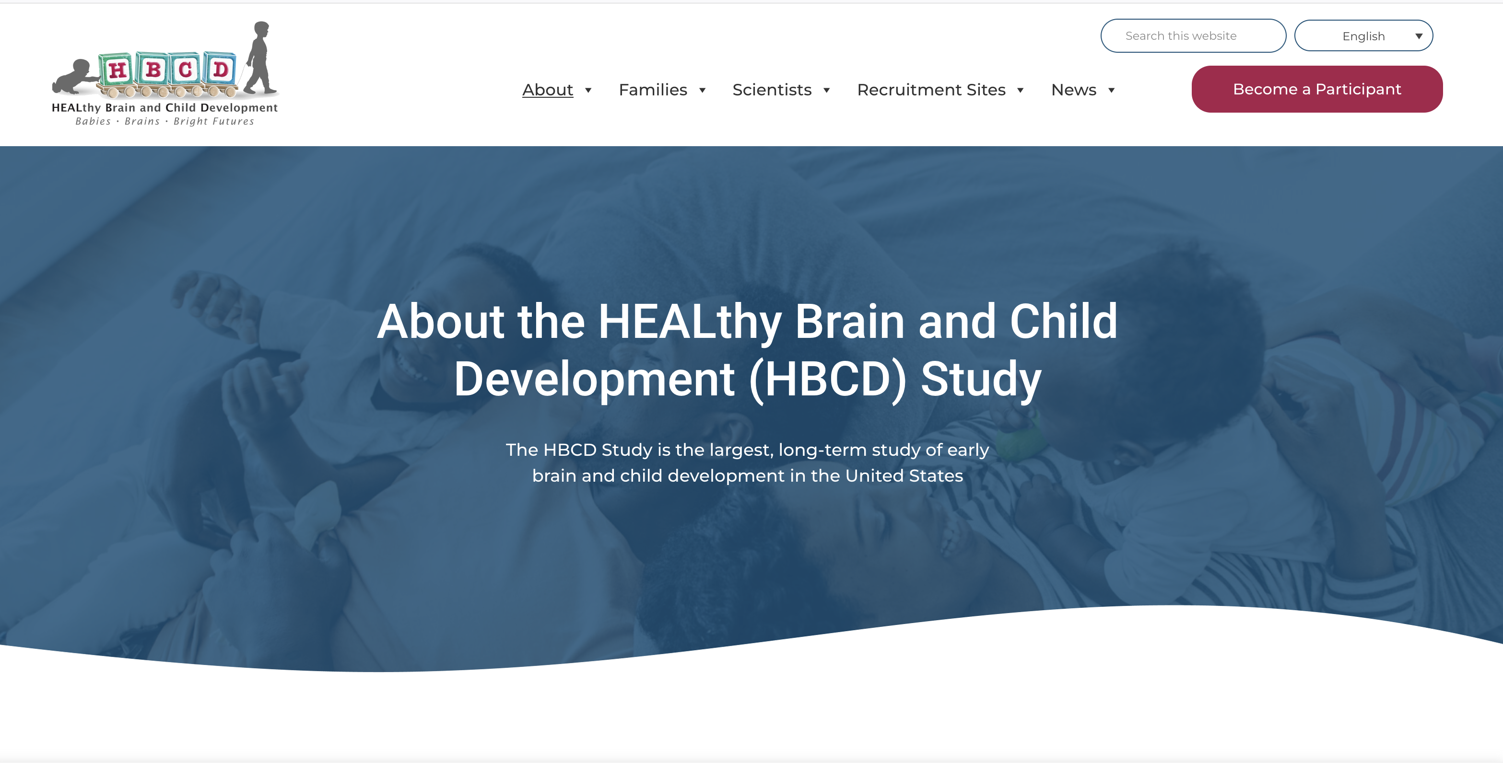
https://hbcdstudy.org/

Slide 7
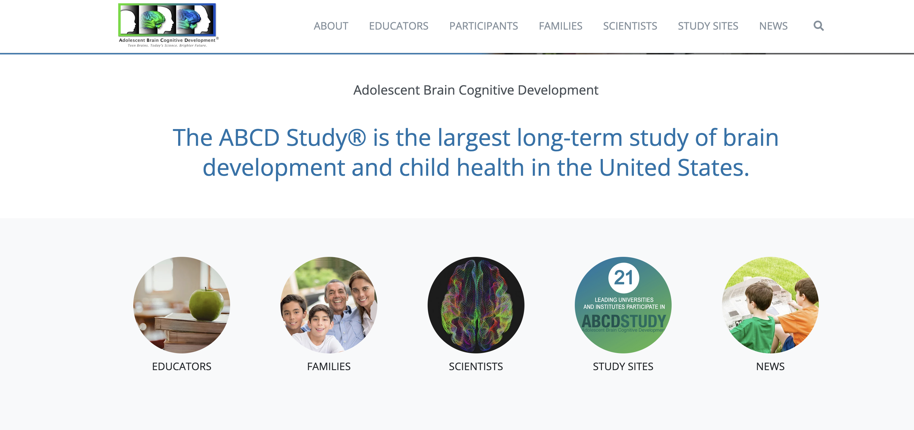
https://abcdstudy.org/
Notes:
Virginia site added.

Slide 8
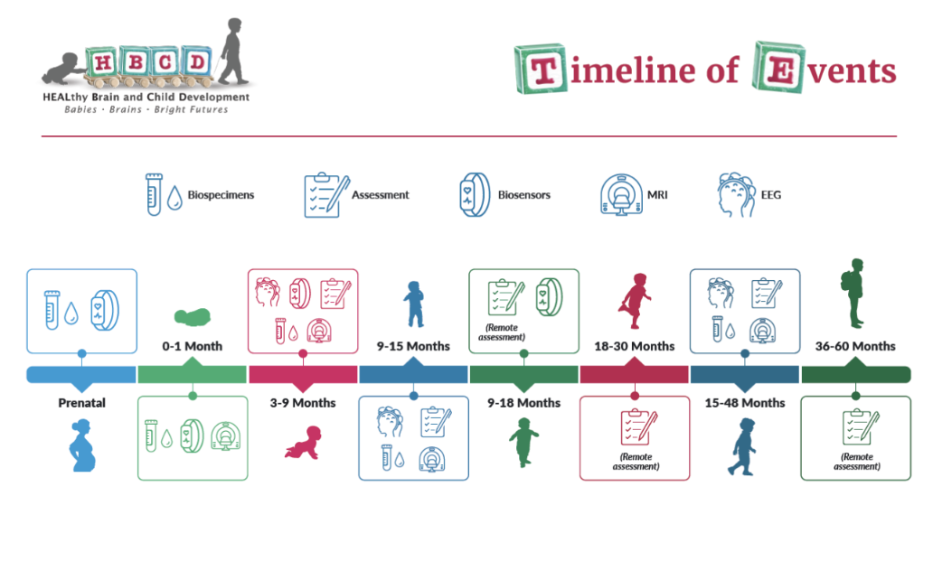
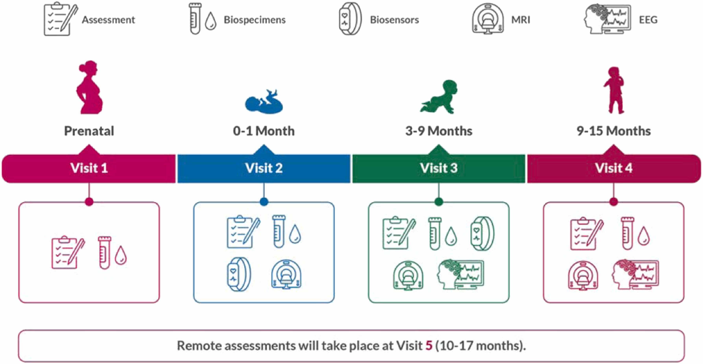

Slide 9
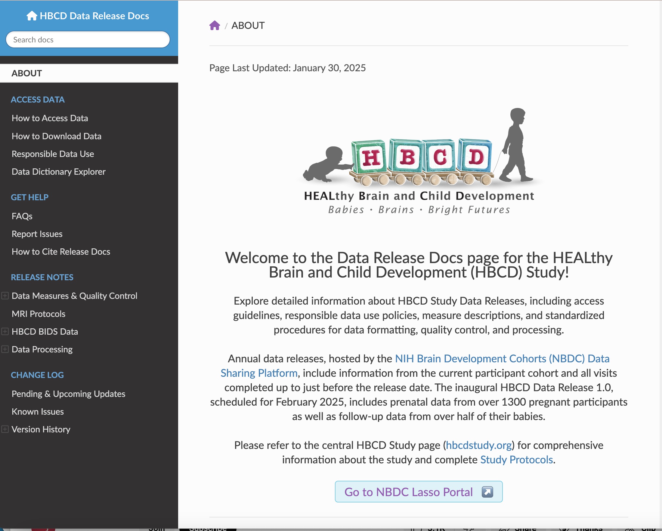
Data Releases
Once a year
Data from the prior year up through June 30
Not waiting for complete data
Same platform as ABCD
Covered by same DUC
DUC Information

Slide 10
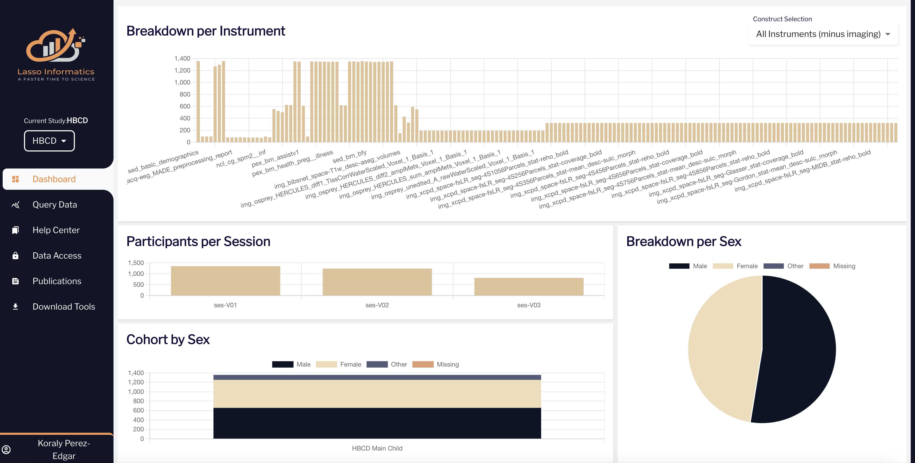

Slide 11
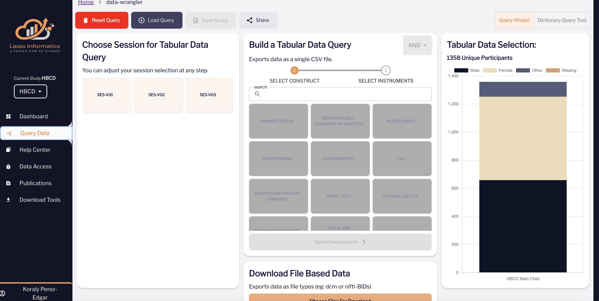
https://nbdc-hbcd-beta.lassoinformatics.com/data-wrangler

Slide 12
